Slide 1
Cloud Computing Architecture

Slide 2
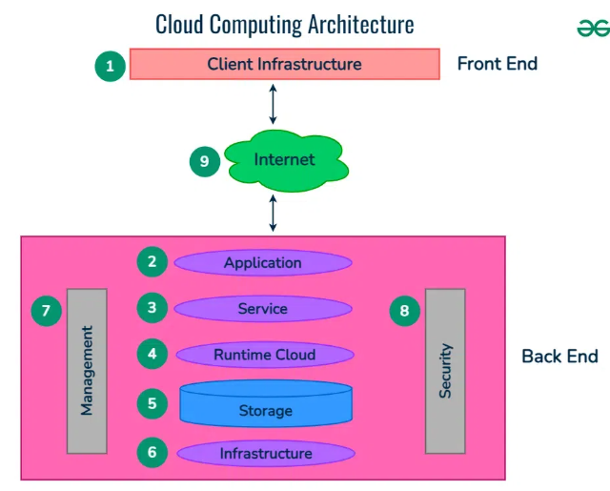

Slide 3
Cloud computing architecture
Cloud computing architecture refers to the components and sub-components required for cloud computing.
These components typically refer to:

Slide 4
Front end ( Fat client, Thin client)
Back-end platforms ( Servers, Storage )
Cloud-based delivery and a network ( Internet, Intranet, Intercloud )

Slide 5
Front-End (Client Side)
Interface for users to interact with cloud.
Accessed via web browser, app, or software.
Example: Google Drive interface.

Slide 6
Back-End (Provider Side)
Includes: Servers, Databases, Storage, VMs, Management Tools.
Responsible for providing services and managing data.
Managed by cloud providers (AWS, Azure, etc.)

Slide 7
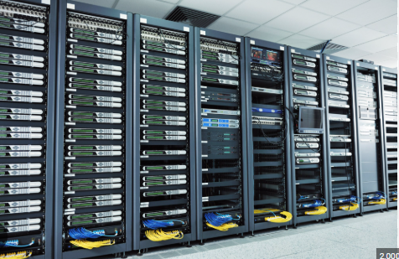

Slide 8
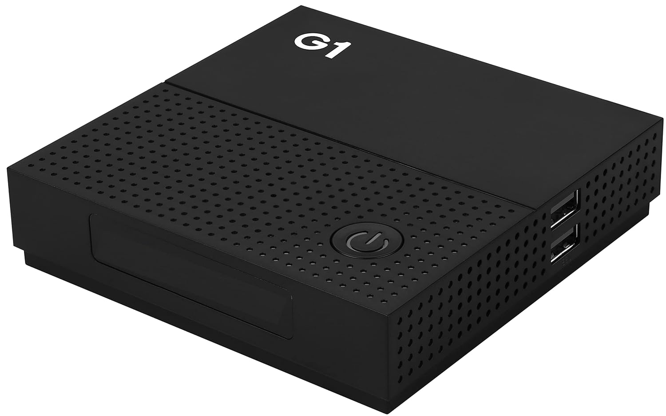
Thin client

Slide 9
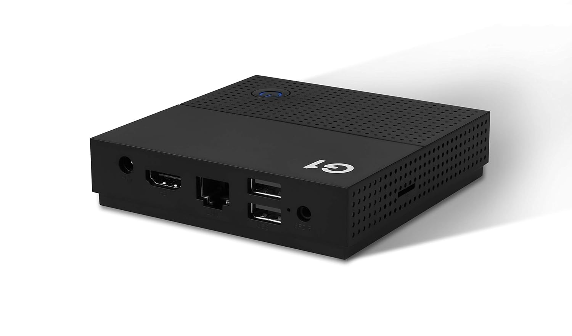
Back view

Slide 10
FAT CLIENT
A Thick Client (also called Fat Client) is a computer or software that performs most of the processing on the client-side (user's device), not on a server.
It does not depend much on the server to function.
It can run applications even without an internet connection.

Slide 11
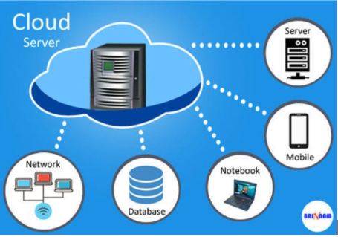

Slide 12
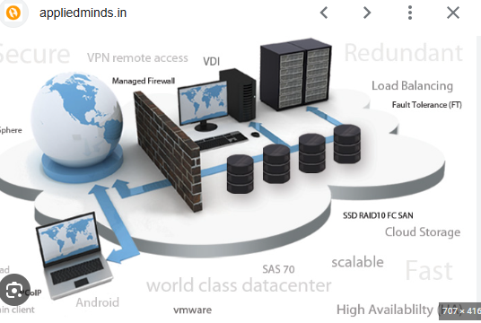

Slide 13
Features of Thick Clients
High Processing Power
Most tasks are done on the client machine.
Less Server Dependence
Only uses server for storing or syncing data (if needed).
Works Offline
Can work even if there is no internet connection.

Slide 14
1. Front End ( User Interaction Enhancement )
The User Interface of Cloud Computing consists of 2 sections of clients.
Thin clients are the ones that use web browsers facilitating portable and lightweight accessibilities and others are known as Fat Clients that use many functionalities for offering a strong user experience.

Slide 15
1. Client Infrastructure (Front End)
This is the user side of cloud computing.
It includes devices like laptops, smartphones, browsers, or apps used to access cloud services.
It provides the interface for users to interact with the cloud.

Slide 16
2. Application
Applications run on the cloud and are accessed by users.
These can be SaaS applications like Gmail, Google Docs, or any web-based app.
It helps users perform tasks without installing anything locally.

Slide 17
3. Service
These are the core services offered by the cloud:
IaaS (Infrastructure as a Service)
PaaS (Platform as a Service)
SaaS (Software as a Service)

Slide 18
4. Runtime Cloud
It provides the execution environment for running applications and services.
Includes software and middleware that support the running of apps.

Slide 19
5. Storage
Handles the data storage in the cloud.
It includes databases, file systems, object storage, etc.
Examples: Google Drive, AWS S3.

Slide 20
6. Infrastructure
Refers to the physical resources like:
Servers
Virtual Machines (VMs)
Network devices
It provides computing power and storage resources.

Slide 21
Management
Takes care of cloud resource monitoring, scheduling, provisioning, and scaling.
Cloud providers use management tools to maintain service quality and efficiency.

Slide 22
8. Security
Provides data protection, encryption, access control, and privacy.
Ensures secure communication and storage.

Slide 23
9. Internet
Acts as the bridge between client (front end) and cloud provider (back end).
All cloud services are delivered over the internet.

